Slide 1
5.3 Round Table

Slide 2
1. “Unexpected” Financial Shocks — Once in a Lifetime Crises Seem to Occur Every Few Years
1987
1988-1993
1994-1995
1997-1999
2007
2009-2010
2000-2005
2008
2011 - 2013
2014-2022
Stock Market Crash
Nikkei Crash
US Interest Rate Hike
Asian Crisis
2000 Tech Meltdown
Subprime
Liquidity crisis
Basel 3
Euro Crisis
Volmageddon
Bear Stearns
FAS 166/167
High-Yield Tumbles
Mexican Peso Crisis
Russian Crisis
2001 Tech Meltdown
Quant Meltdown
GSES
US Debt Downgrade
Covid
Lehman
Financial Reform Legislation
Money Funds Break the Buck
LTCM
9/11 Terrorist Attacks
AIG
London Whale
Russian Invasion Ukraine
European Currency Crisis
TARP
Columbus Day Mortgage Massacre
Goldman and Morgan Stanley become banks
Goldman Sachs
Bubble Bursts
LME Nickel
CP Funding Facility
Bailout Squared of AIG
Greece
Brazil Crisis
GM CDS Correlation
Flash
Crash
Russian Debt Default
Bailout Squared of Citi
Auto Bailout

Slide 3
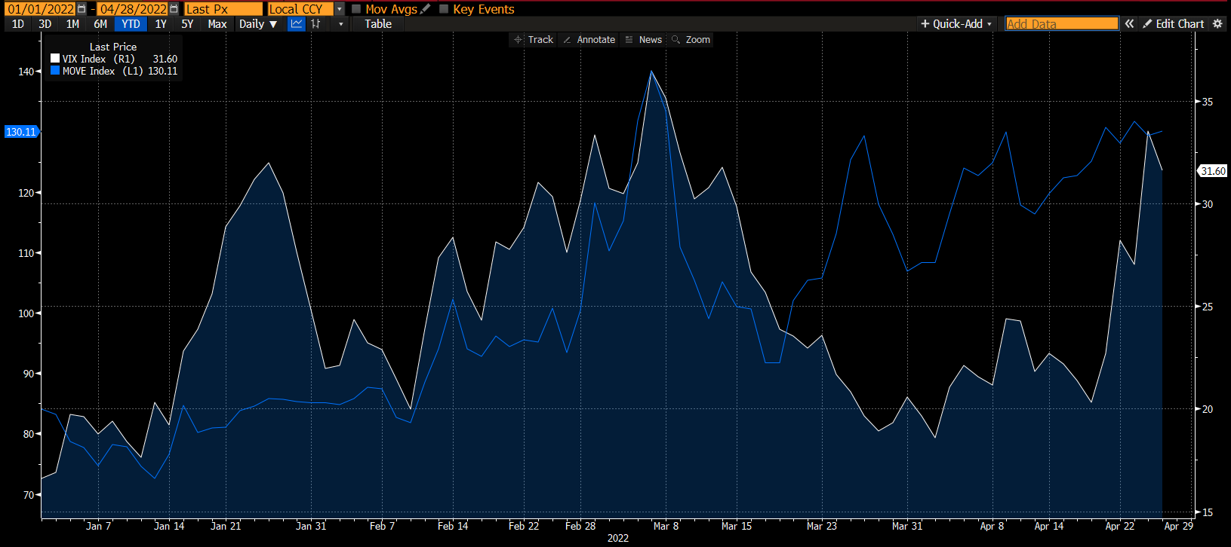
2. VIX & VIX Move Index 1/1/22- 4/27/22
ICE BofAML MOVE index (.MOVE) tracks Treasury yield volatility.
Source: Bloomberg

Slide 4
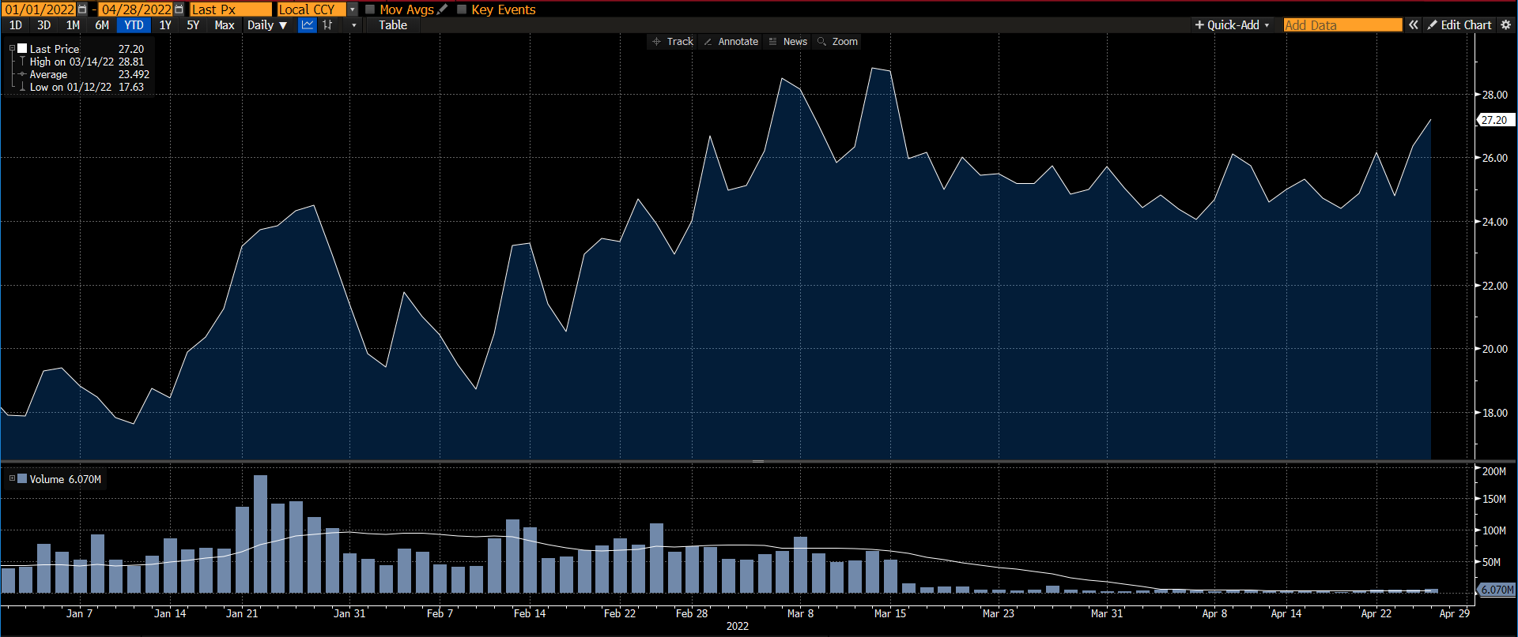
3. VXX 1/1/22- 4/27/22
On March 14, Barclays halted new share creations of the iPath Series B S&P 500 VIX Short-Term Futures ETN (VXX).
Source: Bloomberg

Slide 5
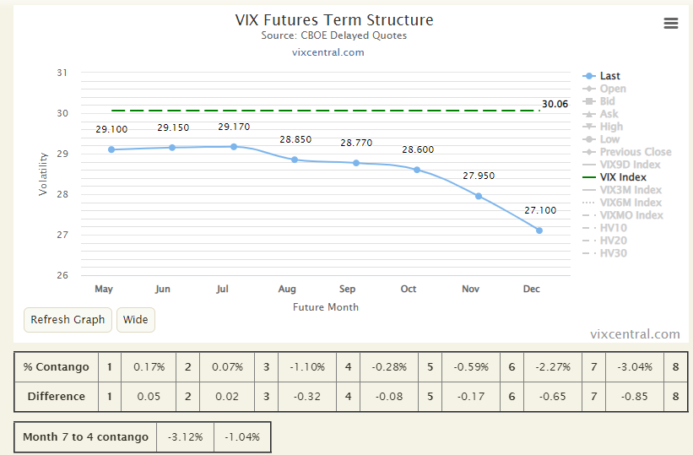
4. VIX Term Structure as of 4/27/22
Source: http://vixcentral.com/

Slide 6
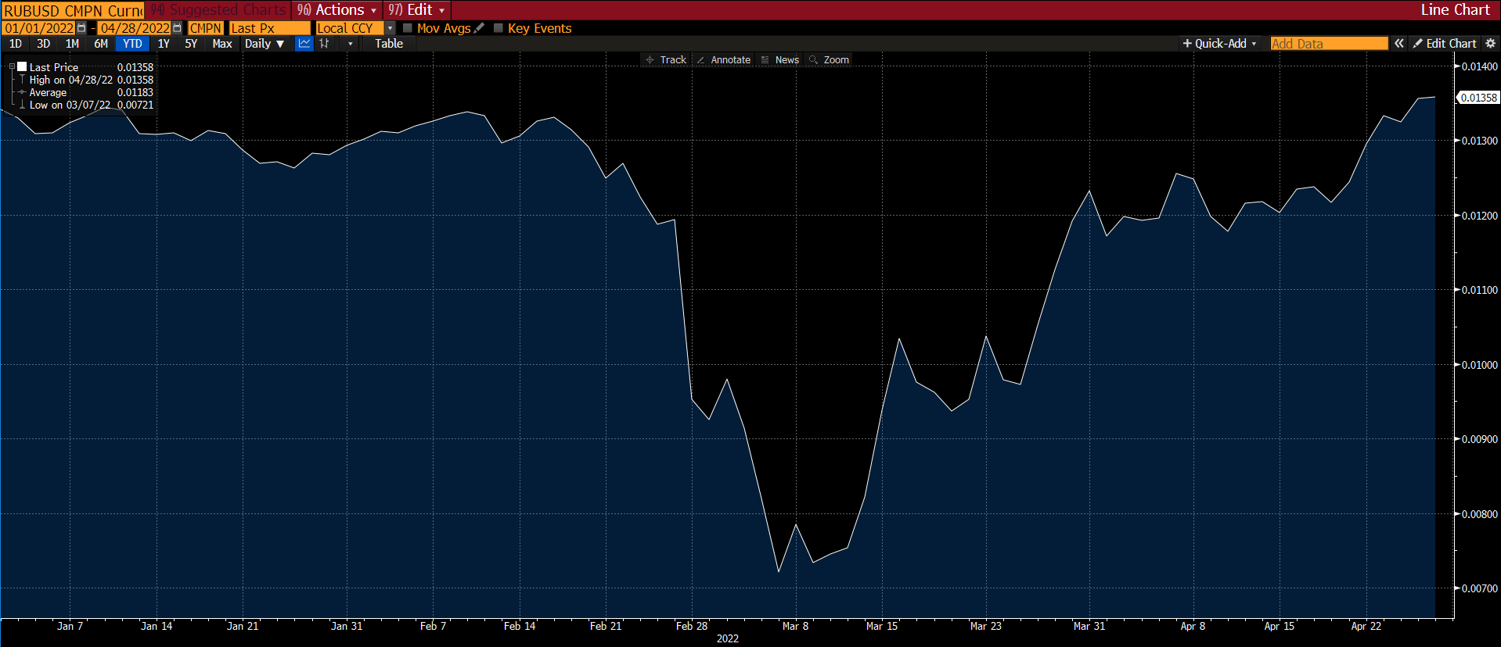
5. Ruble/USD 1/1/22- 4/27/22
Source: Bloomberg

Slide 7
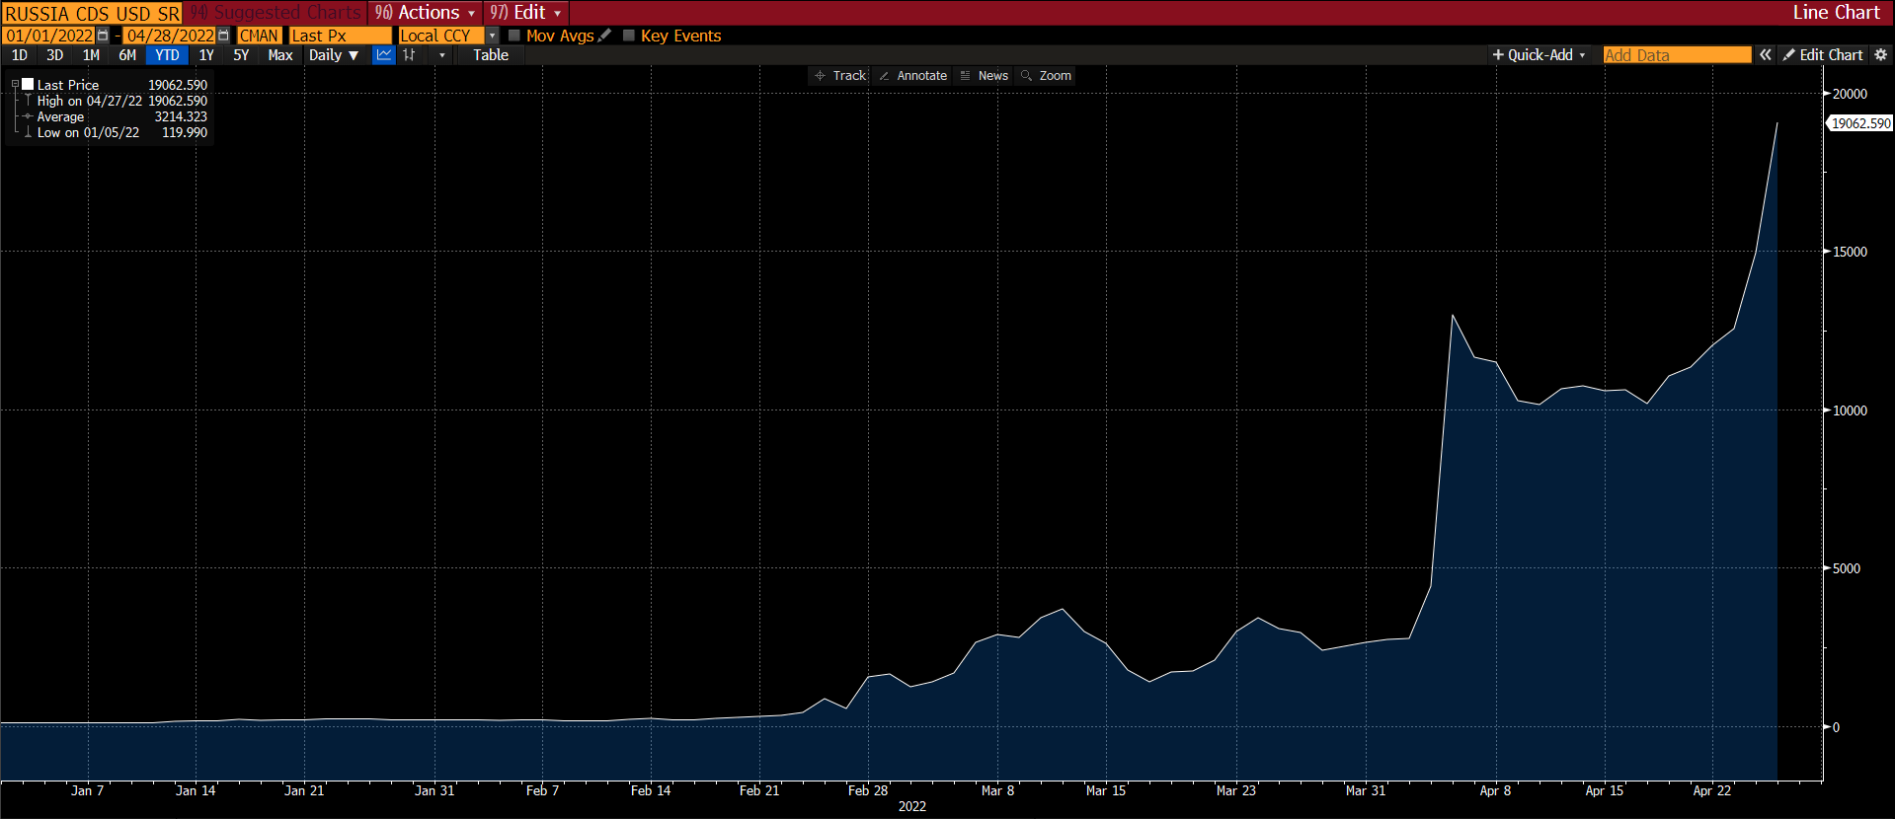
6. Russia 5 yr CDS 1/1/22- 4/27/22
Source: Bloomberg

Slide 8
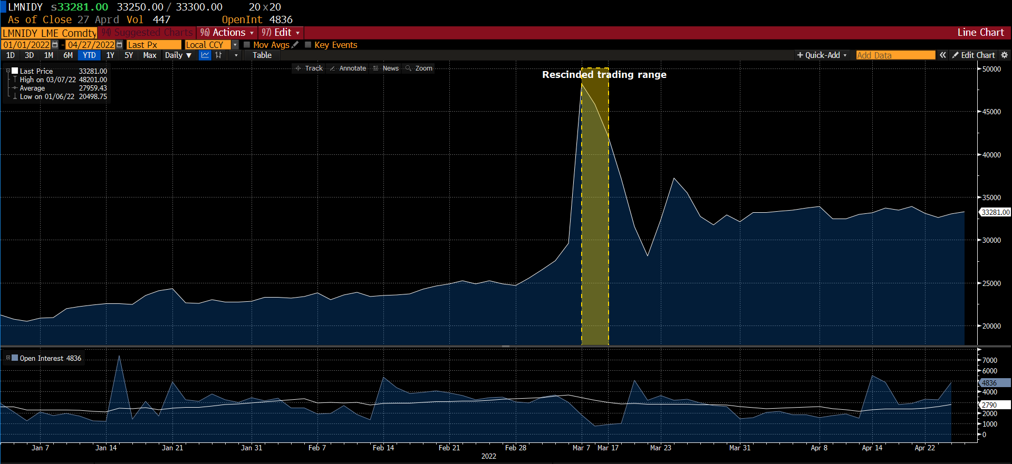
7.1. Nickel Spot price
Suspended: 8 March 2022 08:15 UK time
Reopened: 16 March 2022
Daily price limits: The LME has introduced 15% upper and lower daily price limits for all of its physically delivered metals (and cash-settled cobalt to ensure consistency across its two cobalt contracts), to provide an extra market stabilization mechanism.
Source: Bloomberg

Slide 9
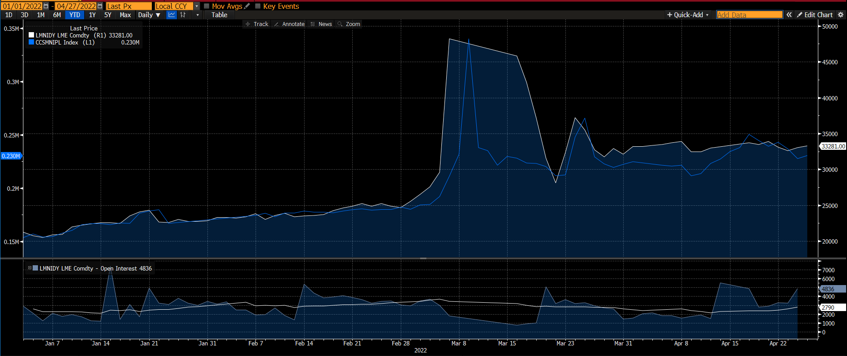
7.2. LME nickel vs Shanghai nickel spot comparison
CCSMNIPL Index: China Shanghai Changjiang Nickel Plate Spot Price
Source: Bloomberg

